Slide 1
Color Wheel
Color science

Slide 2
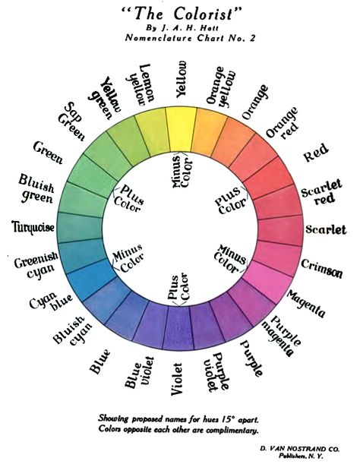

Slide 3
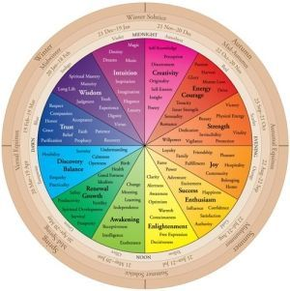

Slide 4
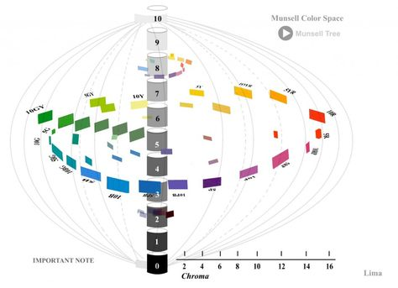

Slide 5
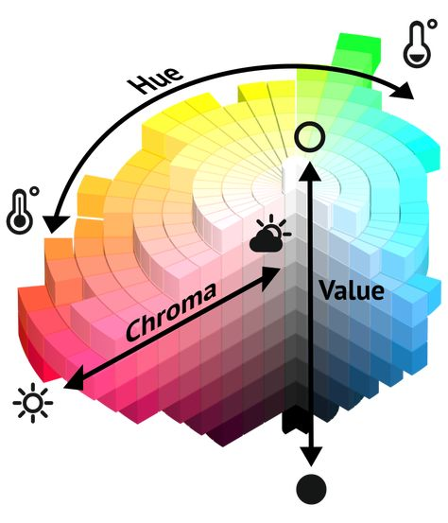
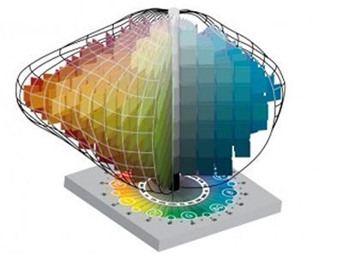
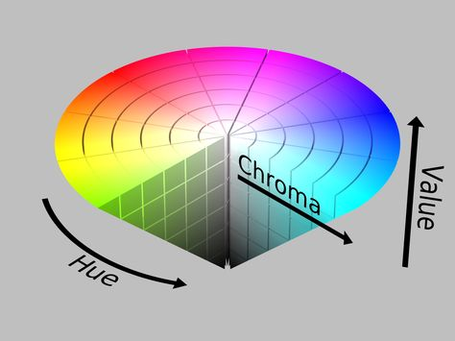

Slide 6
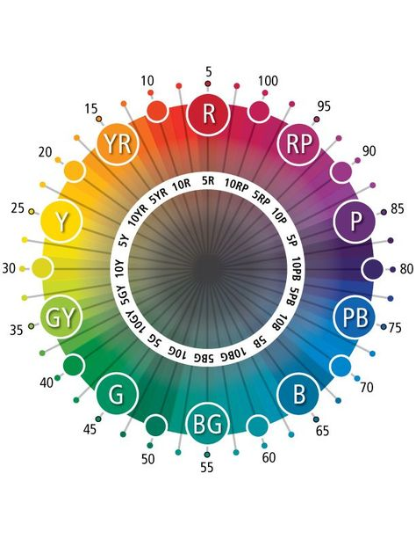

Slide 7
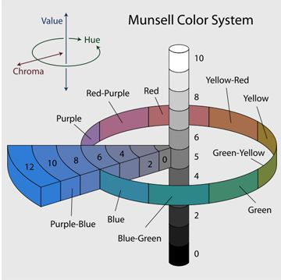
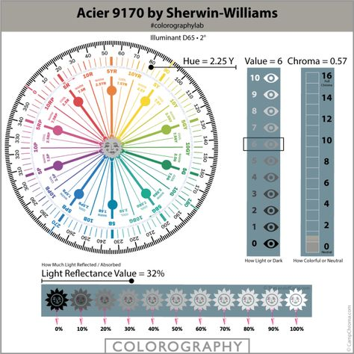

Slide 8
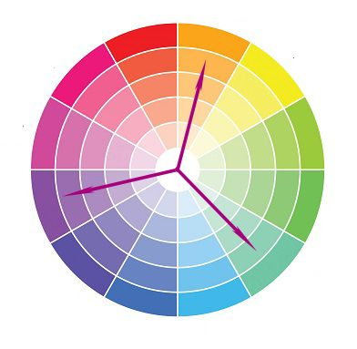
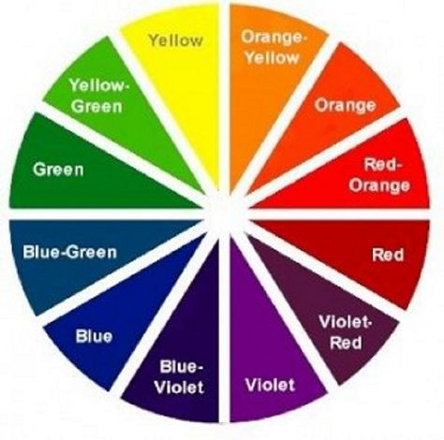

Slide 9
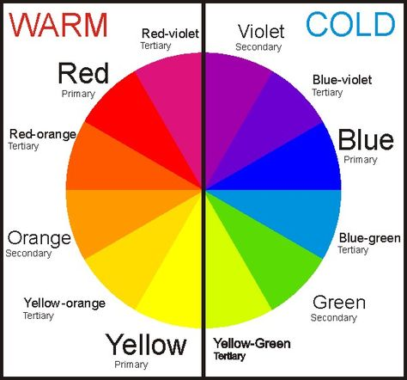
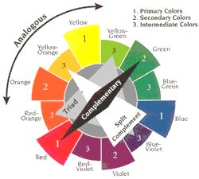

Slide 10
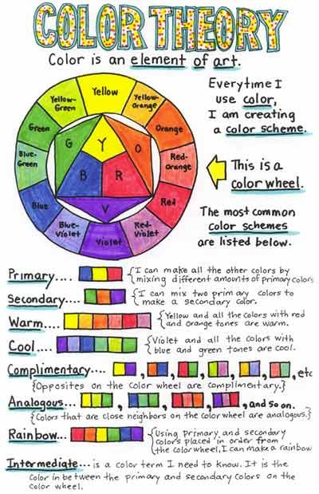
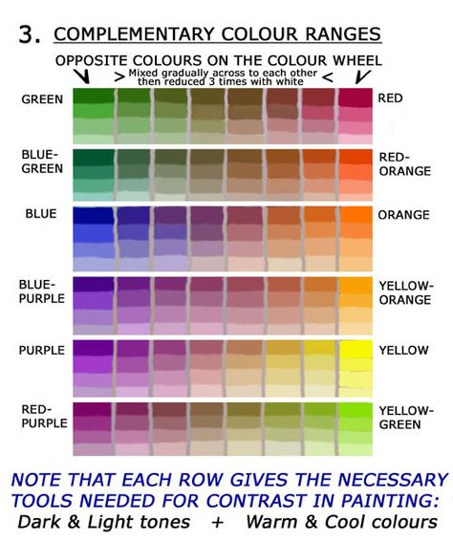

Slide 11
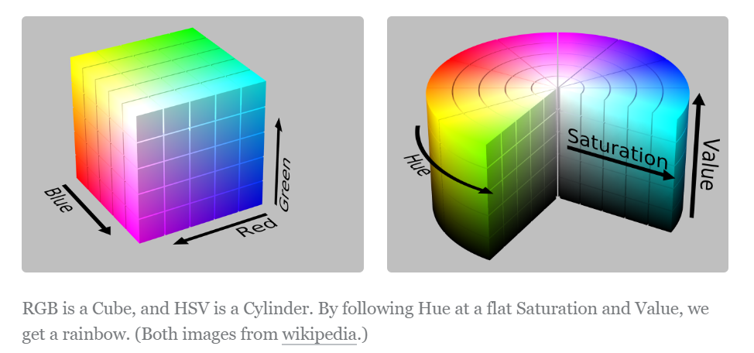
RGB vs. HSV

Slide 12
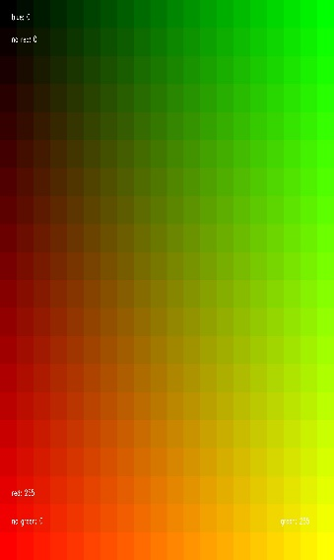
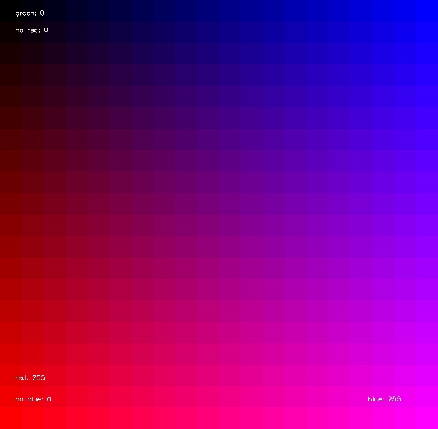
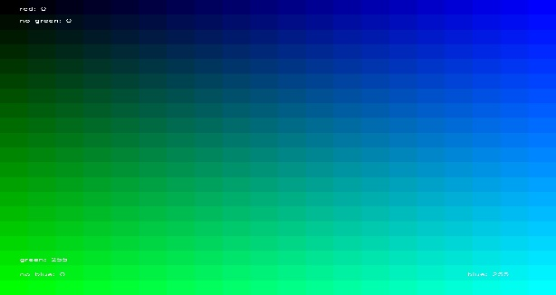
R
B
G

Slide 13
RGB
For the purposes of this survey, we’re working inside the RGB space of the average monitor, so this data is useful for picking and naming screen colors. And really, if you’re reading this blog, odds are you probably—like me—spend more time looking at a monitor than at the outdoors anyway.
- https://blog.xkcd.com/2010/05/03/color-survey-results/

Slide 14
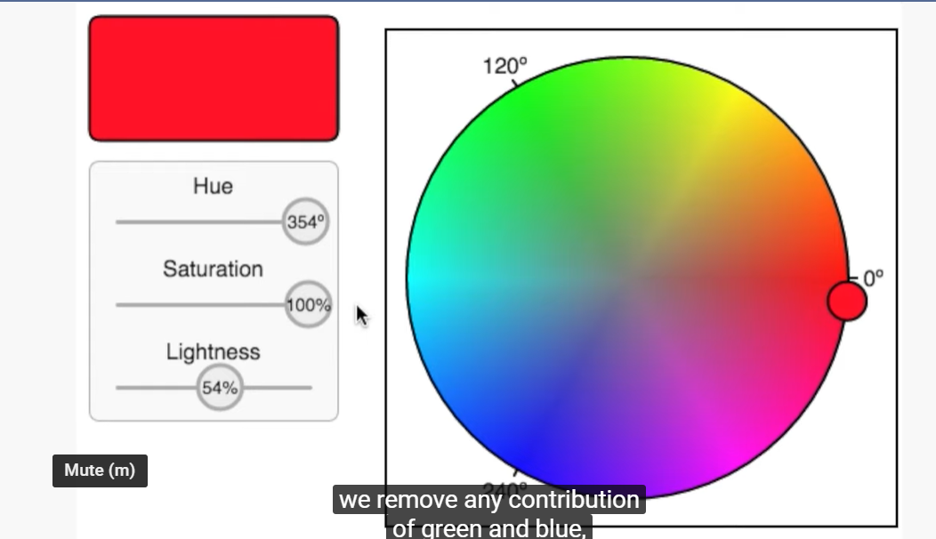
HSV = HSB / HSL
Hue Specification:
Red falls between 0 and 60 degrees.
Yellow falls between 61 and 120 degrees.
Green falls between 121-180 degrees.
Cyan falls between 181-240 degrees.
Blue falls between 241-300 degrees.
Magenta falls between 301-360 degrees.
https://www.lifewire.com/what-is-hsv-in-design-1078068
Advantage over RGB: more intuitive way of finding colors
HSV = hue, saturation, value
HSL = hue, saturation, lightness
Hue (color):
Color wheel color
Domain = [0, 360°] in degree angles
To categorize into intervals of basic colors
Saturation:
Domain = [0, 100] in percent, where 0 is gray and 100 is the pure color
Adding gray desaturates (achromatic = colorless), removing gray saturates (=chromatic)
To «tone» the color
Value/brightness:
Domain = [0, 100] in percent, where 0 is black and 100 is the pure color
Adding black darkens, removing black lightens
To «shade» the color
Lumination:
Doamin =[0, 100], where 0 is black, 50 is the pure color (=value) and 100 is white
Adding black darkens, adding white lightens
To «shade» and to «tint» the color
Pure hue has no white, black, gray or complementary color in it.

Slide 15
HSV color wheel in 30°-steps on hue wheel

Slide 16
cyan
Green-blue
180°
Blue-yellow
150°
210°
Green
blue
120°
240°
Green-yellow
90°
270°
purple
300°
60°
magenta
yellow
30°
330°
Red-yellow
orange
0°
red

Slide 17
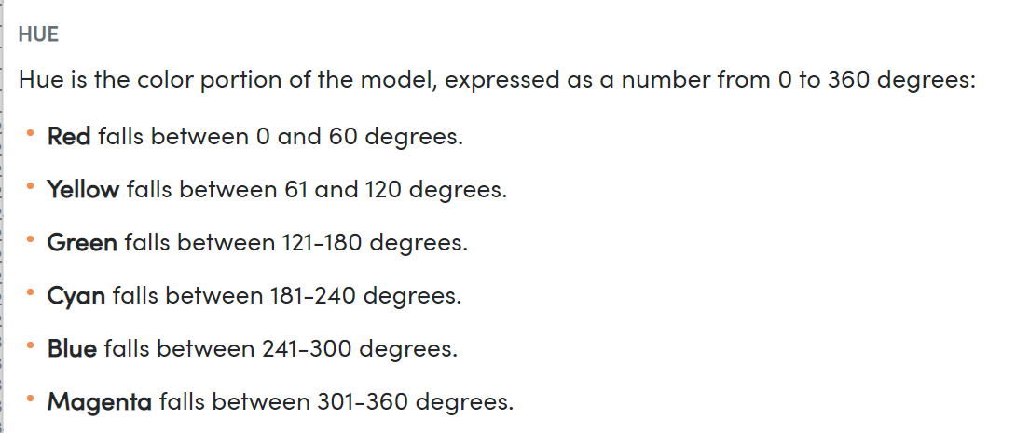
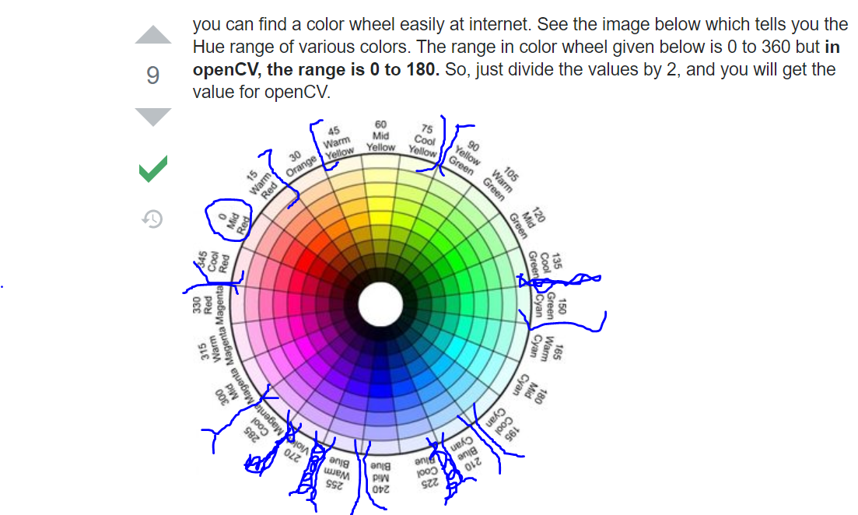
HSV Color Wheel: Center + Range detection
https://www.lifewire.com/what-is-hsv-in-design-1078068
8 color categories
Tweaked based on looking at HSV color wheel colors
Red: 0°; range: ]337.5°-15°]
Orange: 30°; range: ] 15°-45°]
Yellow: 60°; range: ] 45°-60°]
Green: 120°; range: ] 60°-150°]
Cyan: 180°; range: ] 150°-202.5°]
Blue: 225°; range: ] 202.5°-247.5°]
Violet: 270°; range: ] 247.5°-292.5°]
Magenta: 315°; range: ] 292.5°-337.5°]

Slide 18
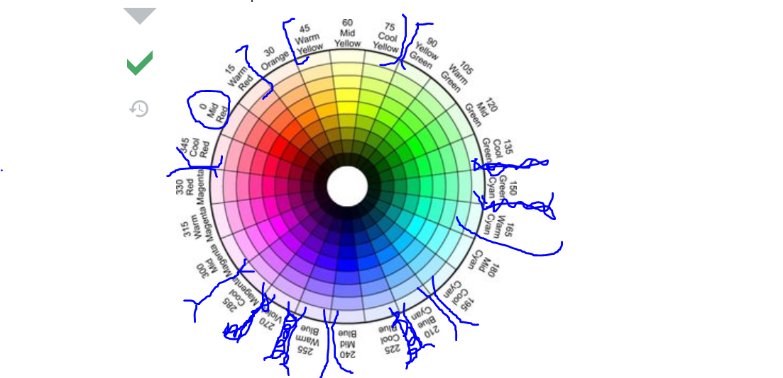
HSV Color Wheel: Center + Range detection
8 color categories
Tweaked based on looking at color visualization of HSVs and http://hslpicker.com at border points
Cyan- and – green border is very hard to determine by waterfall color plotting
Manual tweaking:
{'red': {'pure': 355, 'range': [341,10]}
, 'orange': {'pure': 25, 'range': [11,40]}
, 'yellow': {'pure': 50, 'range': [41,60]}
, 'green': {'pure': 115, 'range': [61,170]}
, 'cyan': {'pure': 185, 'range': [171,200]}
, 'blue': {'pure': 230, 'range': [201,260]}
, 'violet': {'pure': 275, 'range': [261,290]}
, 'magenta': {'pure': 315, 'range': [291,340]}
}

Slide 19
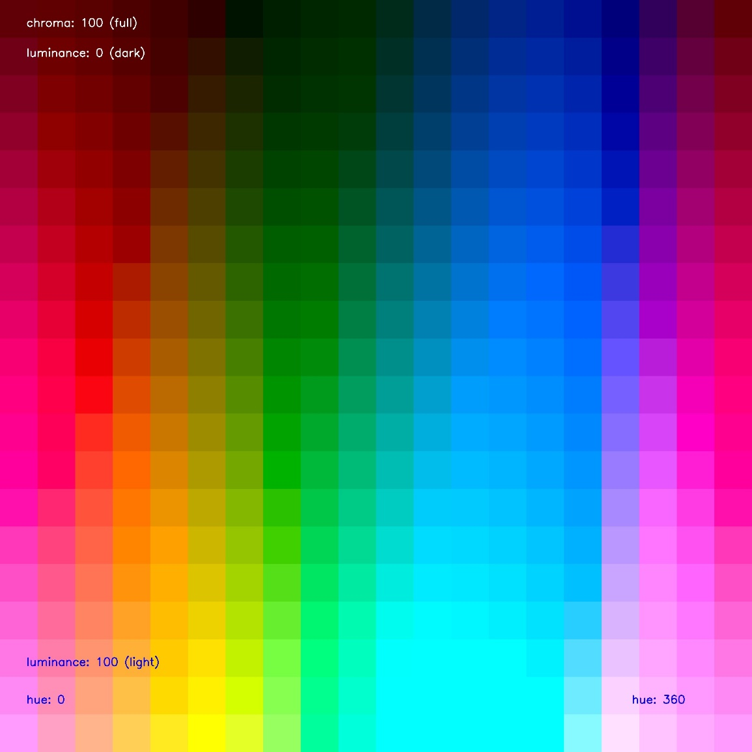
LCH(ab) Color Wheel: Center + Range detection
1. Visual inspection of image to the left:
Constant chroma: 100
Luminance + hue: variations
An approximation:
{'red': {'pure': [50, 100, 20]}
, 'orange': {'pure': [70, 100, 30]}
, 'yellow': {'pure': [90, 100, 50]}
, 'green': {'pure': [50, 100, 70]}
, 'cyan': {'pure': [100, 100, 300]}
, 'blue': {'pure': [30, 100, 310]}
, 'violet': {'pure': [0, 100, 320]}
, 'magenta': {'pure': [70,100,360]}
}
2. Convert color category centers directly from the HSV table.

Slide 20
Color Wheel: Range detection
+ 3 non-colors:
Black, gray and white
Black is defined as an interval in value
Value = [0, 20]
Gray is a function with saturation and value as parameters.
Determine gray with regression and plotting some hsv points in 2D.
Linear function best suited among all other functions, because highest R2 for 10 data points.
Saturation = [0, sat] where: Value = -0.75 sat + 95 and sat = [0,100] and value = [20,95]
White is defined with saturation and value as parameters
Saturation = [0, sat], where sat = value – 95 and value = [95, 100)

Slide 21
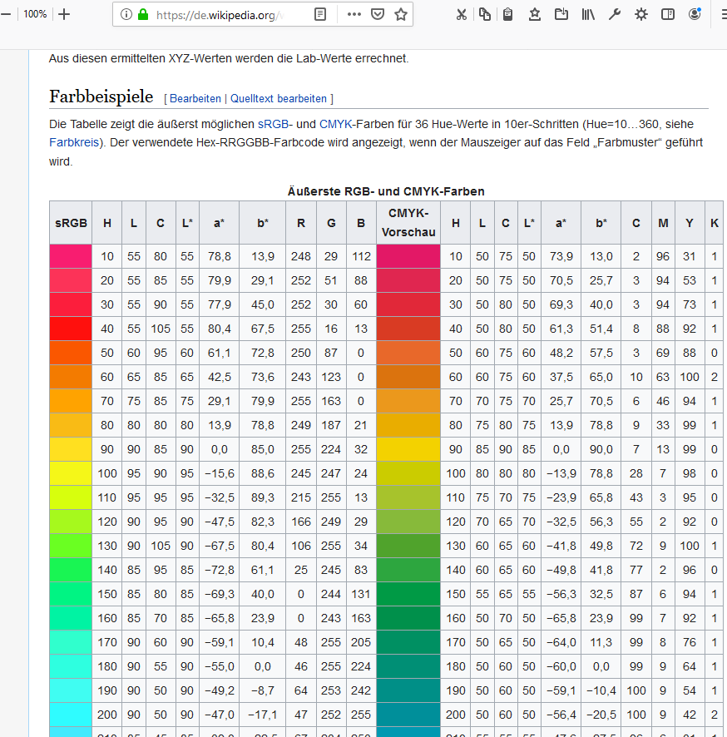

Slide 22
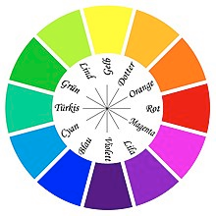
Wrong HSV color wheel found on google:
Dotter and violet colors are not on any 30° multiple of the wheel
Blue-yellow color is missing on the color wheel

Slide 23
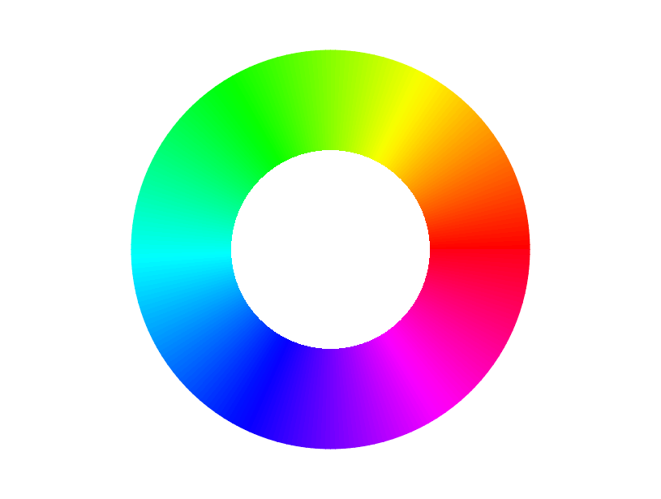
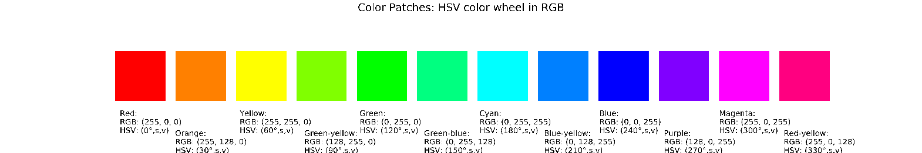
HSV color wheel
The color wheel has green and blue areas that are relatively big as compared to yellow, but where no qualitative differences in hue are perceptible – the greens and blues stay the same
Solution: use LAB (=RGB) and LCH (=HSV) color space to have steps where colors are perceptually equally distant to the human eye
The greens in the seq of colors are not perceptually as different as the reds, for example
Disadvantage

Slide 24
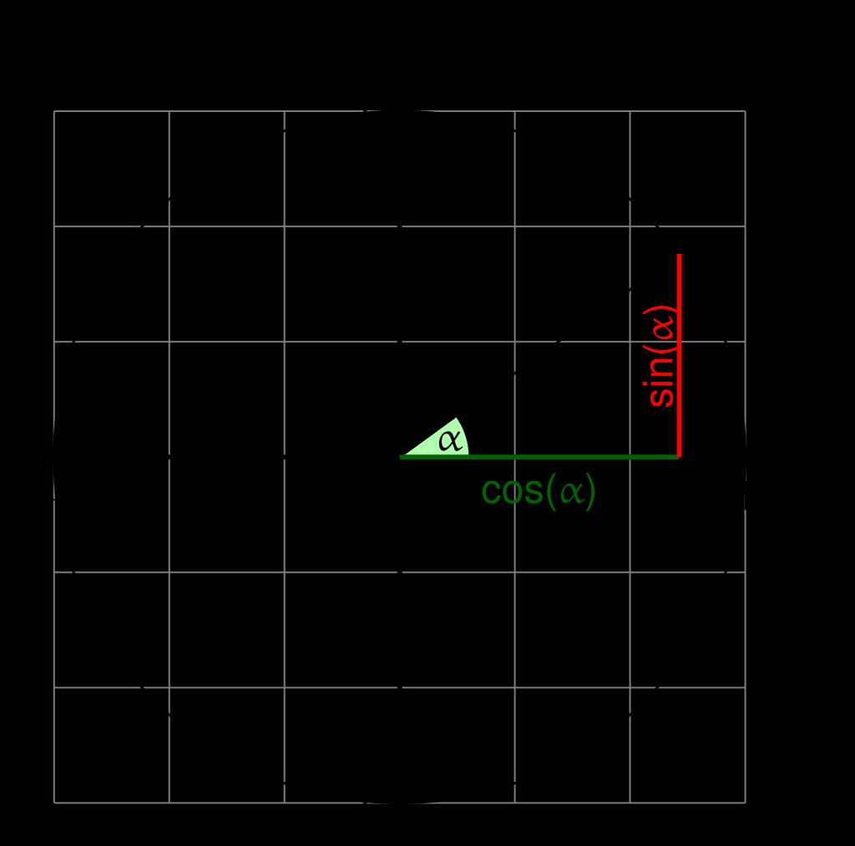
Conversion LAB to LCH
Trigonometry
Use trigonometry to write own conversion function

Slide 25
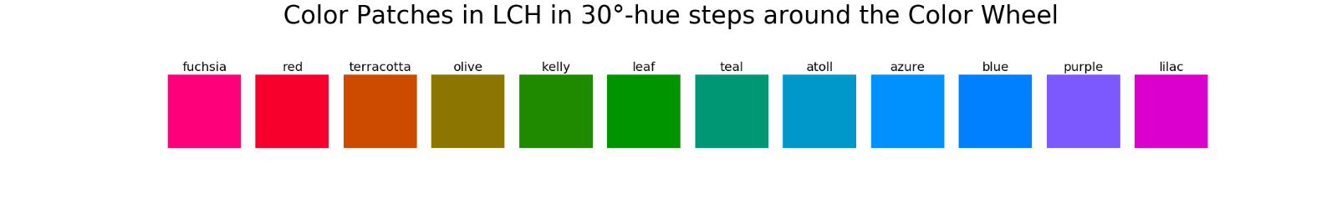
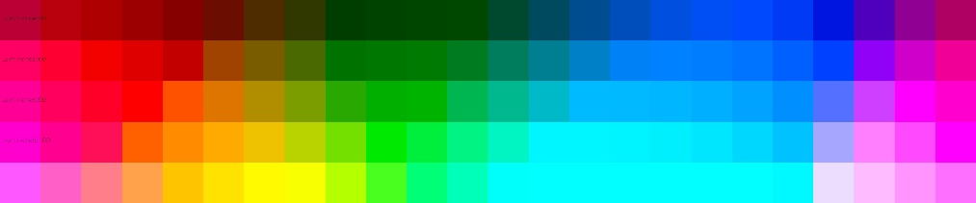
L*a*b color wheel
Now, the colors are perceptually queall distant to the human eye
But, there are three blues, no yellow and three green color categories
Solution: do a linear combination with luminance
No - Solution: get color thesaurus for each of the 12 hues and work out their l*a*b values (see Lindner) – does not work, because ‘red’ is not RGB(255,0,0) due to cultural color naming differences
Disadvantage
Basic Colors, Itten p. 22
6 colors: https://colorthesaurus.epfl.ch/
Red, orange, yellow, green, blue, violet
Conclusion: try to break down 12 hues into 6 that fit into these color categories.
Compute borders between hue centers
Problem: no gray, white, black, brown categories

Slide 26
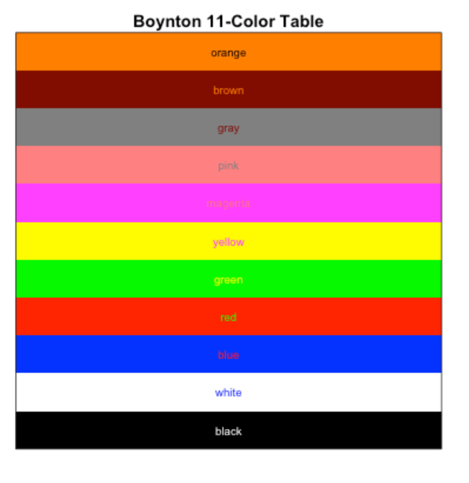
Color Categories
Disadvantage
Not more than 12 color categories
Boynton’s colors: orange, brown, gray, pink, magenta, yellow, green, red, blue, white, black
Problem: no gray, white, black, brown categories
Solution: Robert M. Boynton. Eleven Colors That Are Almost Never Confused. In SPIE Proc. #1077 - Human Vision, Visual Processing, and Digital Display, pages 322-332, Bellingham, WA, 1989. SPIE.

Slide 27
Basic Color Categories
For Color Classification

Slide 28
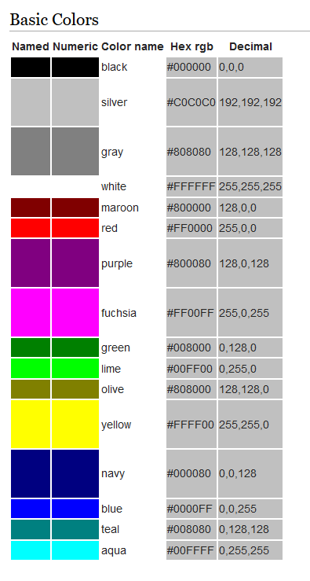
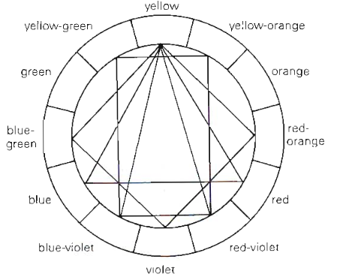
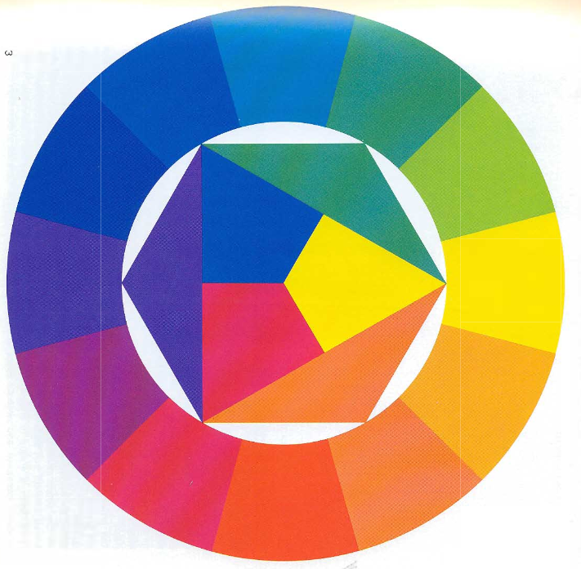
Basic Colors, Itten p. 22
6 colors: https://colorthesaurus.epfl.ch/
Red, orange, yellow, green, blue, violet
16 colors
https://www.w3.org/wiki/CSS/Properties/color/keywords

Slide 29
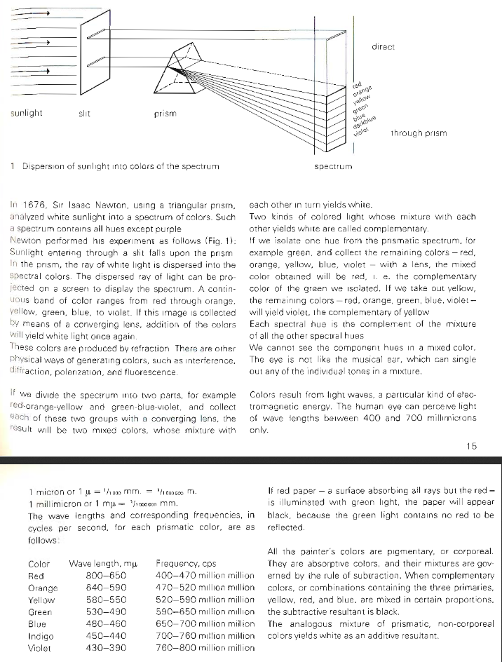
Basic Colors, Itten p. 16

Slide 30
Color Thesaurus

Slide 31
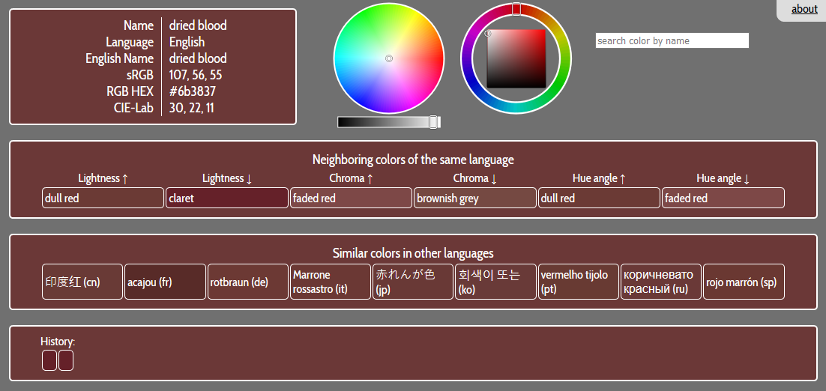
Lindner
https://colorthesaurus.epfl.ch/

Slide 32
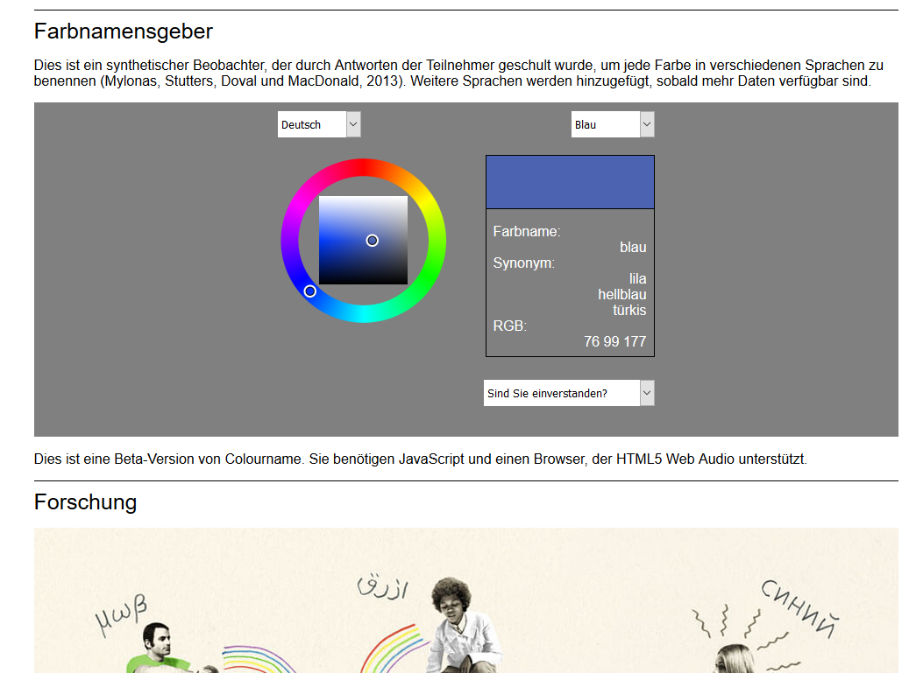
Dimitris Mylonas
https://colornaming.net/#colour-namer

Slide 33
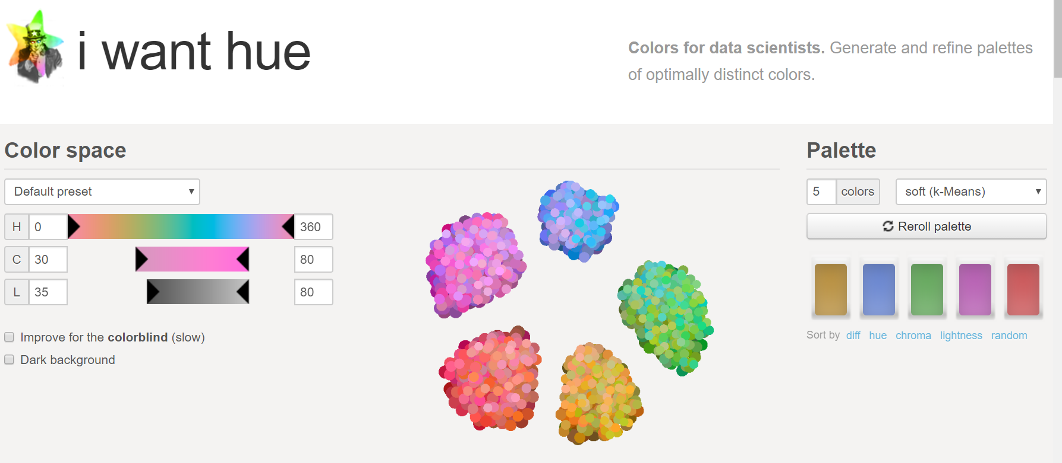
Make a Color Palette
https://medialab.github.io/iwanthue/

Slide 34
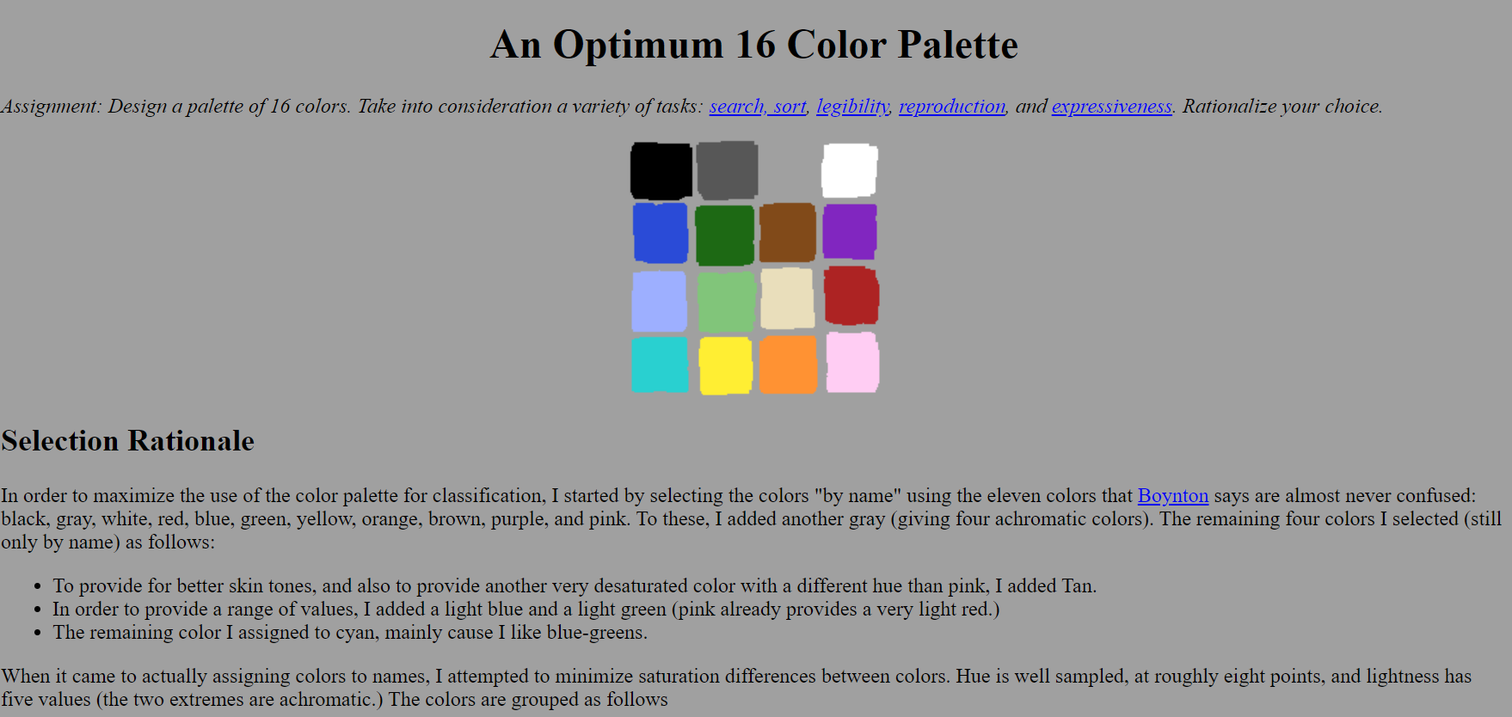
An Optimum 16 CPs
http://alumni.media.mit.edu/~wad/color/palette.html

Slide 35
Color Palette

Slide 36
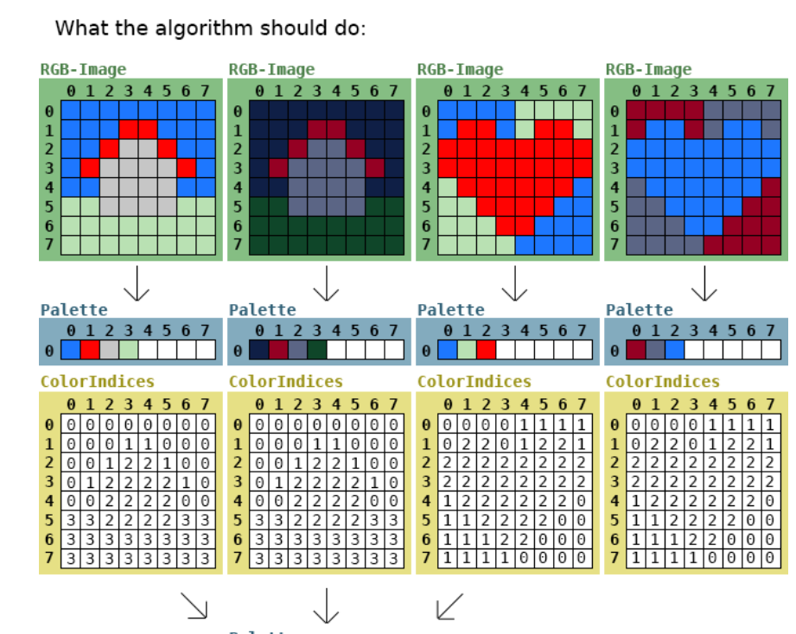
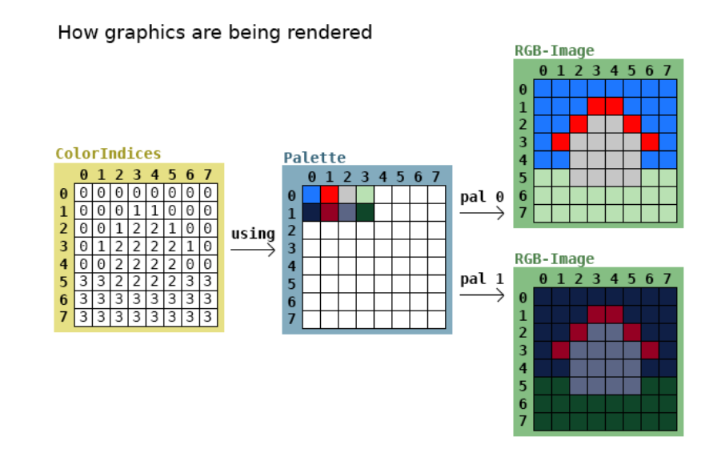
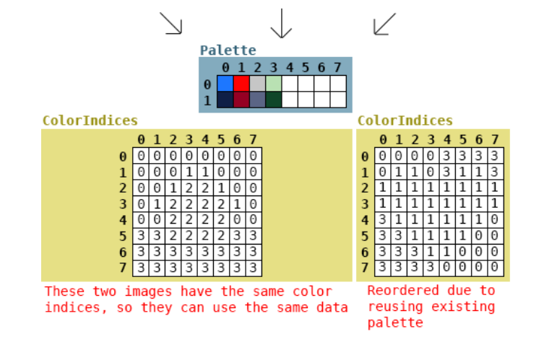
Color Palette
https://stackoverflow.com/questions/46410132/algorithm-for-many-images-and-their-color-palettes

Slide 37
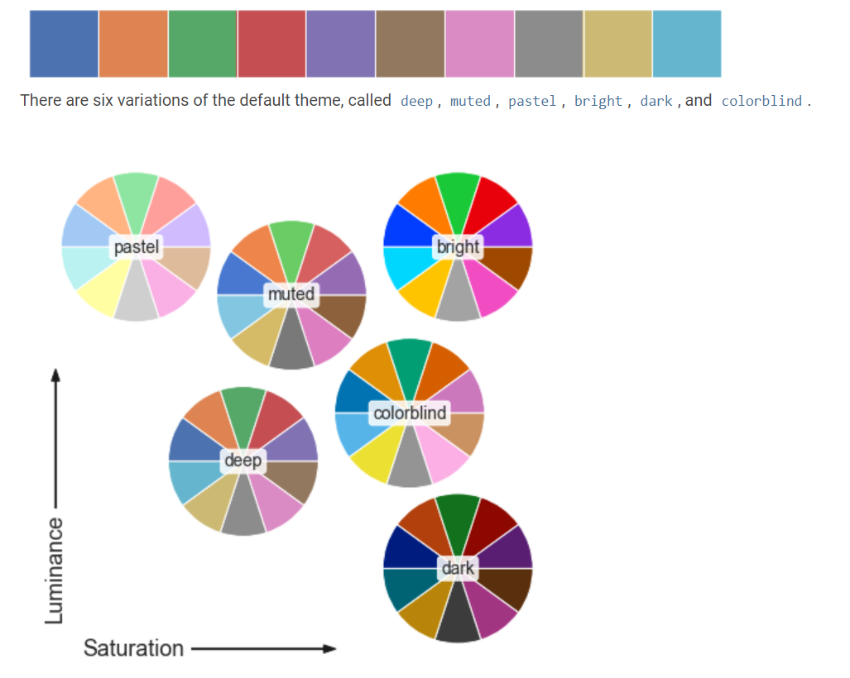
seaborn
https://seaborn.pydata.org/tutorial/color_palettes.html

Slide 38
colormap

